Slide 1

Survey analysis –
What did Our FM Colleagues tell us?
Mike Arnold, MD, MHPE, FAAFP

Slide 2
Analyzing Survey responses
Simpler than you would think

Slide 3
Methods for Interpreting Survey Data
Descriptive Statistics – the basic results
Cross-Tabs (Chi Squared) – Compare result (DV) with demographic data (IDV)
Logistic Regression – Compare likelihood of result (DV) with demographic (IDV)

Slide 4

Statistics Software Note
There are so many free open-source software packages
I used JASP – open-source software by Dutch universities
My bias towards tall, smart, happy people

Slide 5

Descriptive statistics
Get right from Excel
  E.g. Percentage of the sample respondents who said they were confident or very confident with diagnosing HFpEF.
  Include the denominator!
    Denominator should be the ones that weren’t blank.
    26% of the 197 respondants who answered were confident or very confident
Should not be the only stats you use

Slide 6
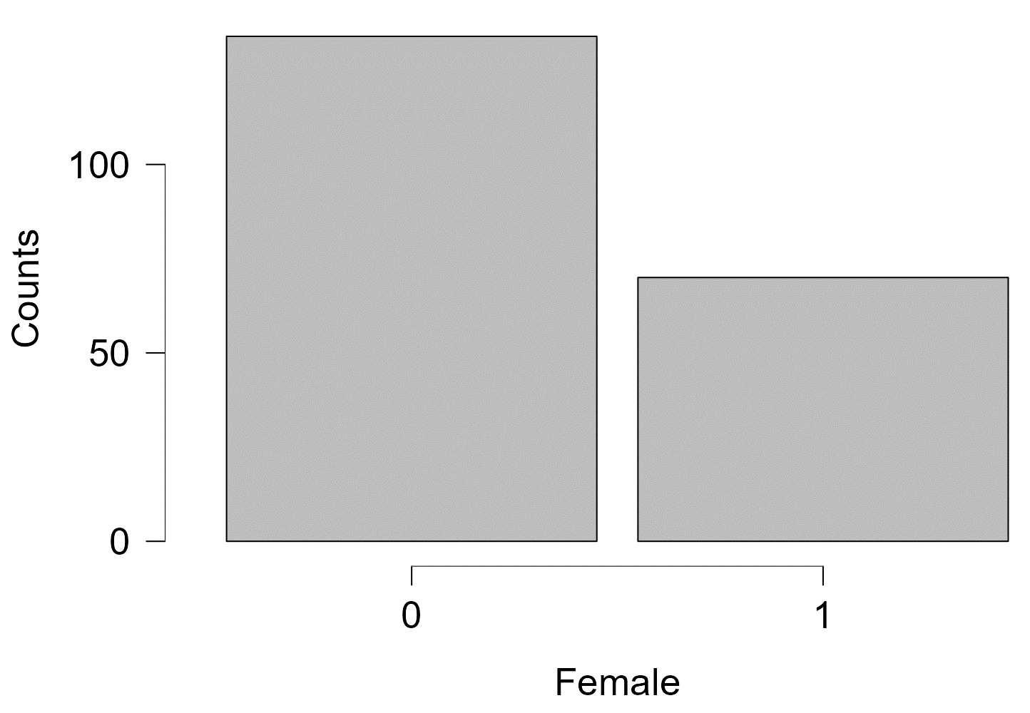
Demographics data

Slide 7
Proportion of Encounters with Older Adults
What percentage of your clinical encounters are 65 years old and older? | Older adults >20% of encounters
10-20% | 0
10-20% | 0
1-9% | 0
<1% | 0
>35% | 0
1-9% | 0
>35% | 0
10-20% | 0
21-34% | 1
21-34% | 1
<1% | 0
21-34% | 1
21-34% | 1
21-34% | 1
1-9% | 0
10-20% | 0
<1% | 0
10-20% | 0
<1% | 0
1-9% | 0

Slide 8
Simplified for Comparison
Use logic to give a 1 if choose:
  21-35%
  >35%

Slide 9
Diagnostic criteria for Diagnosing Dementia

Slide 10
Simplified for Comparison
Use logic to give a 1 if:
  Strongly Agree or
  Agree

Slide 11
Contingency tables (Chi-Square)
Compare responses with a demographic variable you suspect may matter
  E.g. Do women respond differently than men?
  E.g. Do physicians out of residency 5 years or less respond differently?
Builds from descriptive statistics – what changes?
Comparisons should be decided before starting – not just p-hacking

Slide 12
all the choices – too much, not significant
More categories, harder to be significant
Smaller samples in each category – requires an expected number in each block of 5

Slide 13
2x2 Table – Much more doable and shows significance

Slide 14
Presenting
More than significance – compare to total
  While 44% of respondents (36 of 81) who were O5 or above agreed that they could identify when cognitive impairments affect a patient’s daily life, only 31% of respondents who were O4 or below did.
    What is the difference (effect size)? Is it enough to be important?
  This difference was statistically significant (p<0.05)
    Statistical significance only matters if we believe it’s important if it is.

Slide 15
Logistic Regression
Compare variable by probability
  E.g. Do women have a higher odds of answering this way than men?
  E.g. Do physicians out of residency 5 years or less have a higher odds of knowing this fact?
Similarities to Chi-Squared – but answers in Odds Ratio
  Odds Ratio is significant if 95%tile doesn’t cross 1.00
Next Slide– Are junior physicians less likely believe they can identify when cognitive impairment affects a patient’s daily life?

Slide 17

Thank you
Now you get to choose:
Design a survey
or
Process Results

